Slide 1
Kraken Wrangling for Dummies
Go Modules Dependency Management at Scale
Notes:
Good morning. My name is Dylan Bourque and welcome to Day 2 of GopherCon.
I know generics is the cool new toy that everyone is excited to play with, but I'm here to talk about the last "hot new thing", Go modules, and how we can make them a bit less like a monster from Greek mythology

Slide 2

About Me
Started coding in BASIC on a Radio Shack TRS-80 in 1986
B.S. in Computer Science from LSU in 1999
Professional developer for 22 years. 7 companies, 4 different industries
Languages: COBOL, C/C++, Java, Visual Basic, C#, JS/Typescript, Python, and …
Go full-time since 2016
Notes:
But first, a little about me
Started coding in BASIC as a teenager in the mid-80s
Got a BS in Comp Sci from LSU in 99
In the 22 years since … a several different industries and a few different languages
Switched from .NET/C# to Go 6 years ago and have never looked back

Slide 3
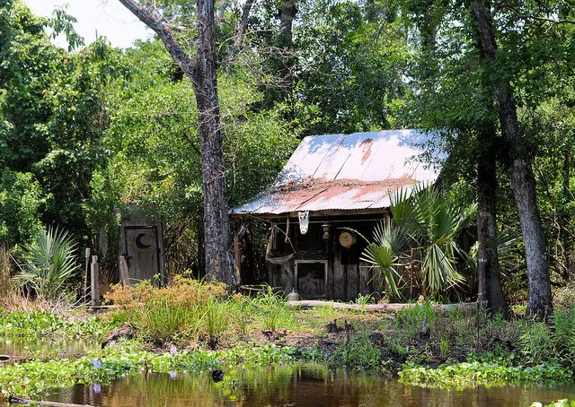
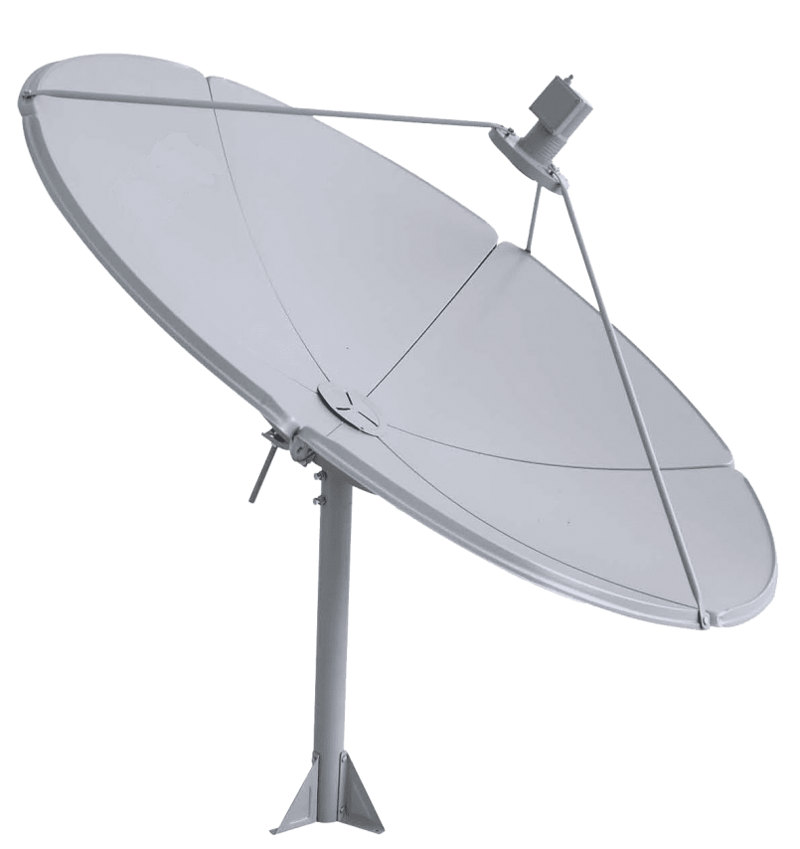
CrowdStrike
3 Years at CrowdStrike
Senior Engineer II
Tech Lead, Platform/Core Maintainers
Not just remote-friendly, but remote-first
Notes:
Started at CS almost exactly 3 years ago in Oct of ‘19 as part of the team that collects and manages host-level metadata (host name, IP addresses, last connection time, etc.). Moved to the new team that I now lead in Aug of ‘21.
From the beginning CS was on board with remote work. I live in south Louisiana and have only been to an office twice, and one of those was when I was interviewing. In fact, here’s a live shot of my “home office” [pic fade in]

Slide 4





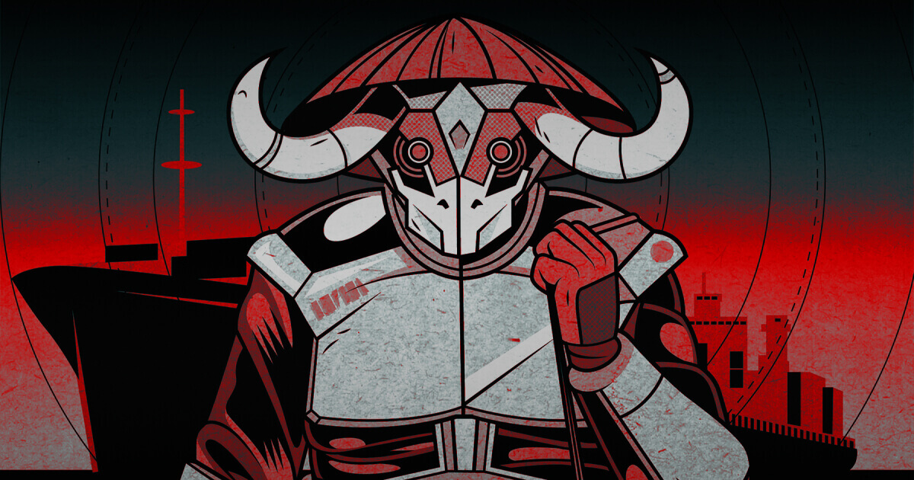
At CrowdStrike
We Stop Breaches
Using Go
Notes:
A quick aside … at CrowdStrike, we stop breaches. There are lots of cool, technical projects going on day to day, including the one I'm going to talk about today, but at the core what we do is prevent bad guys from compromising your systems.
We do that by writing Go. A lot of it. We have hundreds of internal Go modules that bring in a lot of third-party dependencies.
That dependency kraken and all its tentacles is equally as dangerous to our code as the adversaries you see up here are to our customers. This project is the direct result of us dealing with that danger.

Slide 5
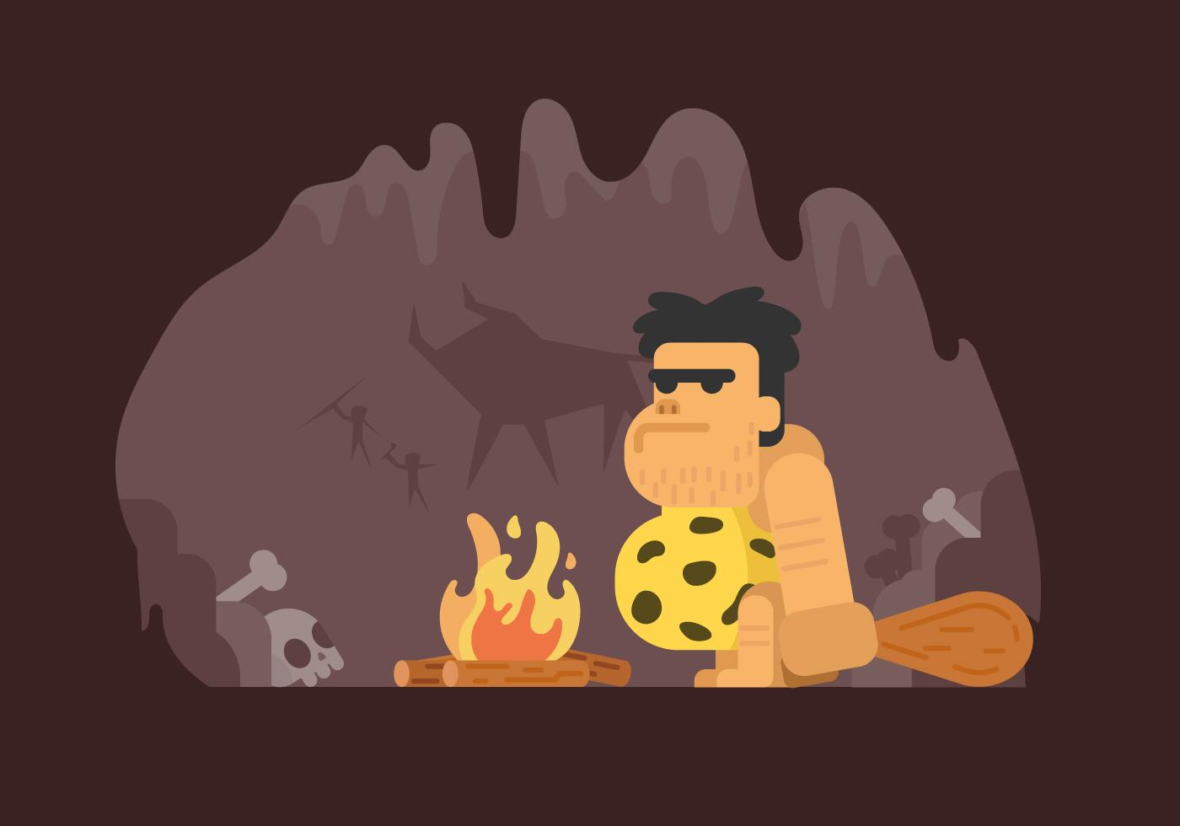
Before Modules
Initially, all Go code lived at $GOPATH/src
Later, Go 1.5/1.6 gave us vendoring
Pros:
All Go code was readily available in one place, your Go workspace
Finding code was simple with tools like find and grep
Cons:
There could only be one* version of a given package on a machine
Builds were not reproducible by default
Notes:
Before we get into the wonders of today, let's take a little trip down memory lane …
In the beginning there was GOPATH and things were simple
There was one, and only one, place where Go code could be … in $GOPATH/src
Technically, GOPATH could reference >1 folder but that seems to be pretty rare in practice
[advance]
This created a problem when separate projects needed to use different versions of the same dependency
Initially, the only way to fix this was to have multiple Go workspaces
The Go team acknowledged this shortcoming and introduced vendoring in Go 1.5
With vendoring enabled, the Go tooling would look in a package-local vendor/ folder first for a dependency before falling back to $GOPATH/src
In Go 1.6 vendoring graduated from "experimental" to officially supported
[advance]
Things were simple back then. Finding the code that your project depended on was pretty straightforward. In almost every case you could locate things with little more than find and grep
Unfortunately there were downsides …
You had to do extra work to handle >1 version of the same dependency and builds were not reproducible by default

Slide 6
And now …
Go 1.11 brought us Go Modules
From the modules reference: “A module is a collection of packages that are released, versioned, and distributed together.”
Pros:
Built-in way for different modules to reference different version of common dependencies
Builds are nearly 100% reproducible
Cons:
File/Folder based searches no longer work as well
Notes:
Fast forward a few years and Go 1.11 introduced Go modules
A module is defined as a collection of Go packages that are released, versioned and distributed together
Directly addresses the previous shortcomings by:
[advance]
Allowing different projects to reference different versions of the same dependency without the "extra work" of vendoring
[advance]
Making builds almost always reproducible because each build will use a deterministic version of each dep based on MVS algo and will verify the contents of that dependency using the checksums in go.sum
Builds _can_ fail if something disappears - we all remember leftpad.js - but things are still much better now
[advance]
The tradeoff is that those simple folder-based search tools got much less useful
Source code for deps is now in version-specific folders in the local module cache and you need to know which version your project is referencing to be able to search in the right place
As an example: I have 30 different versions of golang.org/x/sys in my module cache right now
IDEs can jump directly to dependencies but that only works for the project you have open. As I mentioned before, CS has 100s of projects.

Slide 7
Current Tooling
The go command
The go command provides sub-commands for showing module dependencies
go list -m all
Shows all module dependencies with their versions
Perseus has 51 required dependencies in go.mod but go list -m all outputs 121 results 🤨
go mod graph
Outputs the “graph” of module dependencies as a list of pairs
607 lines for Perseus! 😳
The output of either can be parsed and processed, but who’s got time for that?
Both operate on the “current” version of your module
Neither shows which modules depend on your project.
Notes:
Since find and grep are out, let's talk about the other options
[advance]
Running go list -m all will output a list of your module's dependencies along with their versions. The UX could use some polish, though. Perseus has 51 required dependencies in go.mod but go list outputs 121 results
[advance]
There's also go mod graph, which outputs module dependencies as a list of tuples where the first item is one of your dependencies and the next is a module that it depends on. Each dependency can, and usually does, appear several times. Again, though, the UX is not the best. The "graph" for Perseus is 607 lines!
[advance]
Of course, you could write scripts to parse and process the output and make it user friendly but that's not a simple thing
[advance]
Both look at the "current" version of your module. You need to manually checkout the prior versions of your code to analyze those versions.
[advance]
Neither provide a way to navigate "down" the graph and see what things depend on your project

Slide 8
Current Tooling
pkg.go.dev
The Importers view on pkg.go.dev shows which packages import each package in your module
Except …
It shows packages, not modules
It can only show packages in public repositories
It’s not directly module version aware
Since CrowdStrike has a large number of internal modules, we needed a different solution
Notes:
For that we can look to the package site for help.
Each package has an Importers view that lists other packages that depend on the selected one
Except...
It shows packages not modules
It can only show packages in public repositories
It's not directly version aware
You can navigate to different versions of the containing module to explore across versions
Again … not great UX
[advance]
CrowdStrike has a lot of internal modules so we needed something else

Slide 9

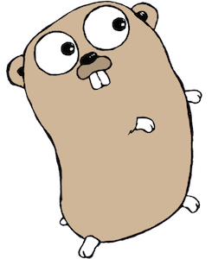
Enter: Perseus
[horns blowing triumphantly]
Stores links between module versions in a graph database
Provides an API to update and query the graph
Also provides a CLI client for the API
32768 different versions of
1138 transitive dependencies
Notes:
Like the mythological hero swooping in to save Andromeda from the monster, Perseus is here to defeat the kraken that is Go module dependency trees with their multitude of tentacles
[advance]
To do that he builds up a graph of version-to-version module dependencies by inspecting the modules' source code, specifically the go.mod files
[advance]
There's a server API for updating and querying the graph
[advance]
and a CLI for interacting with that service

Slide 10


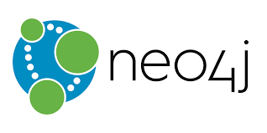
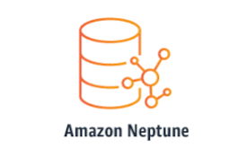

The Database
PostgreSQL instead of an actual Graph DB because …
We had existing infra for running PostgreSQL
The data model is very simple, really just 2 vertices and 2 edges
We have several teams that have built on top of "real" graph databases and their opinions were YAGNI
"You don't use a bazooka to swat flies"
Notes:
We'll start our tour of the project with the database itself.
There's a wealth of options out there for graph databases but we decided on PG
Deciding factors were
[advance]
We had lots of existing infra for running PG and the database model is almost trivially simple, just 2 vertices and 2 edges
[advance]
We also have several internal teams that have built graph databases. Talked to them and they all said YAGNI. You just don't use a bazooka for swatting flies.

Slide 11
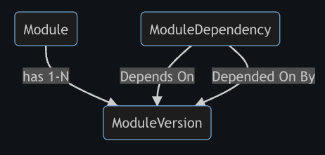
Perseus Data Model
The Module table is a reference to a module, identified by its path, like github.com/CrowdStrike/perseus
ModuleVersion is a reference to Module and a semantic version
ModuleDependency is many-to-many join table, effectively an edge, between two ModuleVersion records
Notes:
Speaking of that simple data model … here it is
Module is a particular Go module, identified by it's module path, like gh/cs/perseus
ModuleVersion is a reference to a module plus a semantic version
And ModuleDependency is a many-to-many join table that represents a bi-directional edge between 2 module versions

Slide 12
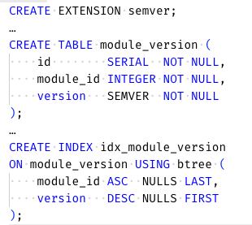
Perseus Data Model
(cont.)
Comparing and sorting by semantic version requires special logic
Perseus needs to do that … a lot
We used the pg-semver PostgreSQL extension so that things “just work”
Also created a secondary index on module ID + version for query performance
Notes:
Since SemVer is really a structured format (3 dot-separated integers plus an optional pre-release suffix) you can't use a plain string
[advance]
Unsurprisingly, Perseus has to compare semantic versions a lot
[advance]
To handle that we used pg-semver PG extension
- Adds a SEMVER data type along with support for comparing and sorting by those values
- Gotcha: Go module versions include the "v" prefix so the service code needed to strip it on the way in and add it back on the way out
- Gotcha 2: Amazon RDS doesn't support the pg-semver extension so you'll have to host PG yourself.
[advance]
Had a pretty good idea that we'd be dealing with a lot of versions so we also went ahead and added an index over module+version to help with query performance

Slide 13
Perseus, the Application
Ships as a single binary that is both the server and a CLI to interact with it
- h/t to Hashicorp for the pattern
The server exposes a gRPC API, along with a RESTful API via grpc-gateway
Uses github.com/soheilhy/cmux to serve both on a single port to make deployment simple
perseus server ...
The client provides an update command for modifying the graph and a query command for retrieving data from it
- perseus update ... and perseus query ...
Notes:
The project generates a single executable that is both the "server" and a CLI for interacting with it
[advance]
There's also a public package with the generated gRPC API types and a Swagger definition for the REST API for other clients
Something I like to do is use cmux to serve HTTP, gRPC, health checks, metrics, etc. on a single port. I find it much easier than having to configure separate ports for each "interface".
[advance]
The CLI uses the generated gRPC client to connect to the server and update or query the graph. It also does the formatting of the raw API results.

Slide 14
Perseus, the Server
✅ What It Does ✅
Implements CRU - no D, for now - operations for manipulating the graph
Add a new module
Add a new module version
Add/Update dependencies for a specified module/version
List known modules/module versions
List dependencies/dependants for a specified module/version
Performs transactional updates against the database, translating API requests into UPSERT operations to avoid duplication
Provides a basic web UI for viewing and navigating the graph
Uses Buf to generate Go code from the .proto API definition
Notes:
The Perseus service is actually pretty straightforward
There's a CRUD API for updating and querying the graph (with deletes coming Soon :tm:)
Today we have update APIs for adding modules and module versions and for adding/updating module dependencies and query APIs for listing modules and module dependencies.
[advance]
All updates are done as transactional upserts so that graph changes are idempotent
[advance]
In addition to the API, the service also provides a basic web-based UI for viewing and navigating the graph
For now, it's pretty simple but we have some plans to improve it
[advance]
Side note: kudos to the team at Buf for 'buf generate'. If any of you are here ... y'all are awesome. :-)

Slide 15
Perseus, the Server
🚫 What It Doesn’t Do 🚫
Walk the graph
Render the graph
Not every consumer will want/need the same behavior and visualizations
K.I.S.S. lets the service avoid code churn
STOP
Notes:
There were also some explicit non-goals for the service
[advance]
The service does not do graph traversals.
Each call to the API returns 1 level of dependencies and it's left to clients, including the Perseus CLI, to handle recursing (or not)
Large graph walks could easily create performance and responsiveness issues
[advance]
The service also does not do rendering/visualization
As is the case with graph walks, rendering can be quite expensive
Pulling in addt'l deps like GraphViz can also increase the attack surface of the service's deployment. We are a security company after all.
[advance]
It also became obvious pretty quickly that different consumer use cases would require different behavior and visualizations
[advance]
KISS FTW

Slide 16
Perseus, the CLI
Updating the Graph
# process the module in $PWD, inferring the version
perseus update .
# process the foo module using v0.11.38
perseus update $HOME/go/foo --version v0.11.38
Parses go.mod for the specified module, extracting the list of direct dependencies and calls the Perseus server to update the graph with the results
Requires that the module repo exists locally and that there is a Go module SemVer tag at the current commit or that the version is specified explicitly
Like before, not processing dependencies recursively keeps things simple
Notes:
Flipping the coin, we use the Perseus CLI to analyze our modules and update the graph
The update command takes a path to a folder that contains the source for a Go module as a required parameter and parses the module's go.mod on disk
For now, the folder must contain a Git repo with a go.mod at the root
If version is not specified we try to deduce it by reading the Git tags at the current commit
By default, we skip pre-release tags but can override
Like before, we chose to keep it simple and not try to recursively process modules

Slide 17
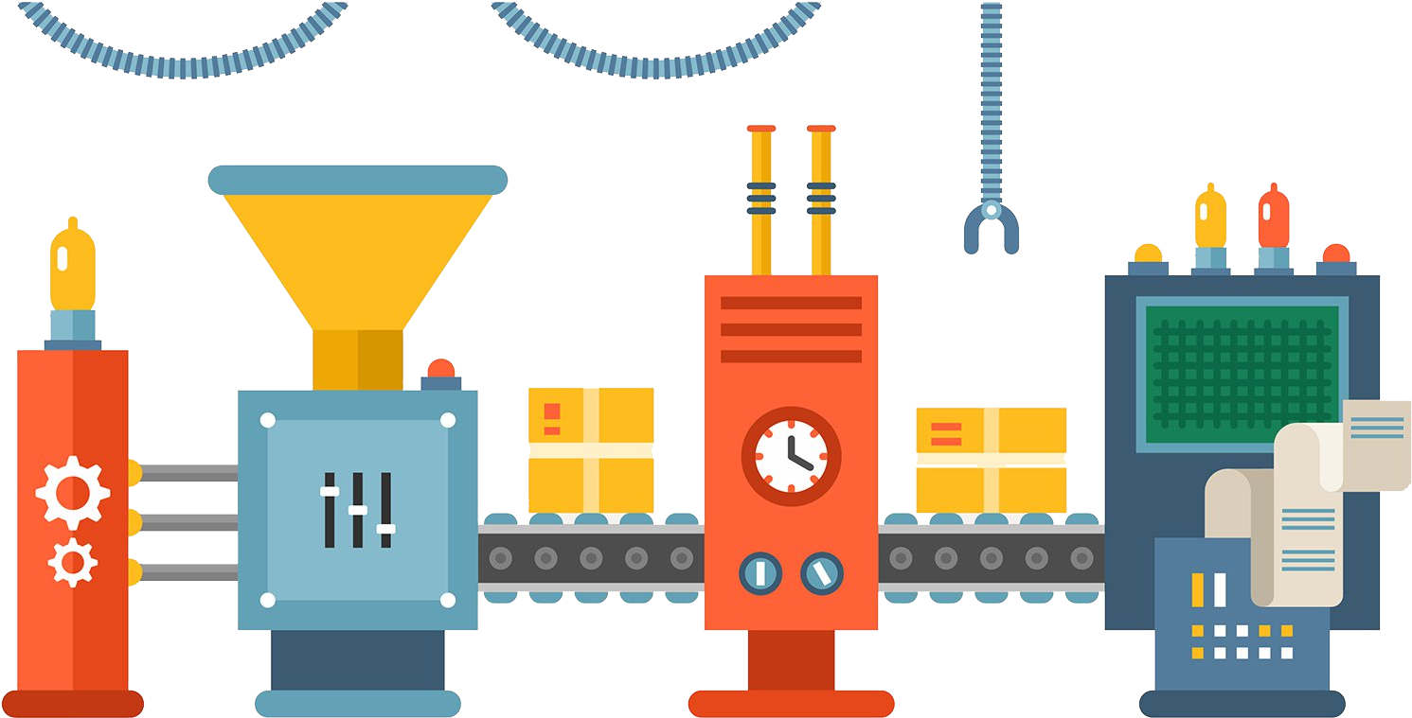
Automating Graph Updates
Write a script
The Perseus GitHub repo includes a Bash script, processmod.sh, that enumerates all of the SemVer tags on a Git repository and executes perseus update for each one
Integrate Perseus into CI/CD
We run perseus update as part of our internal build process when a new stable module version is tagged
Notes:
Now that we have all the pieces in place, we want to populate the graph and keep it up to date as new versions are released
As I mentioned earlier, one of the gaps in the current tooling is determining which modules *depend on* your module.
The catch is that that information only exists in those projects' go.mod files
[advance]
The GH repo includes a Bash script that enumerates the semver tags on a repo and executes perseus update for each one.
For our internal modules, we backfilled the graph by iterating over each repo and running 'processmod.sh.'
This way we were able to build up the full graph one set of links at a time
[advance]
We've also integrated the Perseus CLI into our CI process. When a new stable release is tagged the CI job runs perseus update to add that version to the graph.

Slide 18
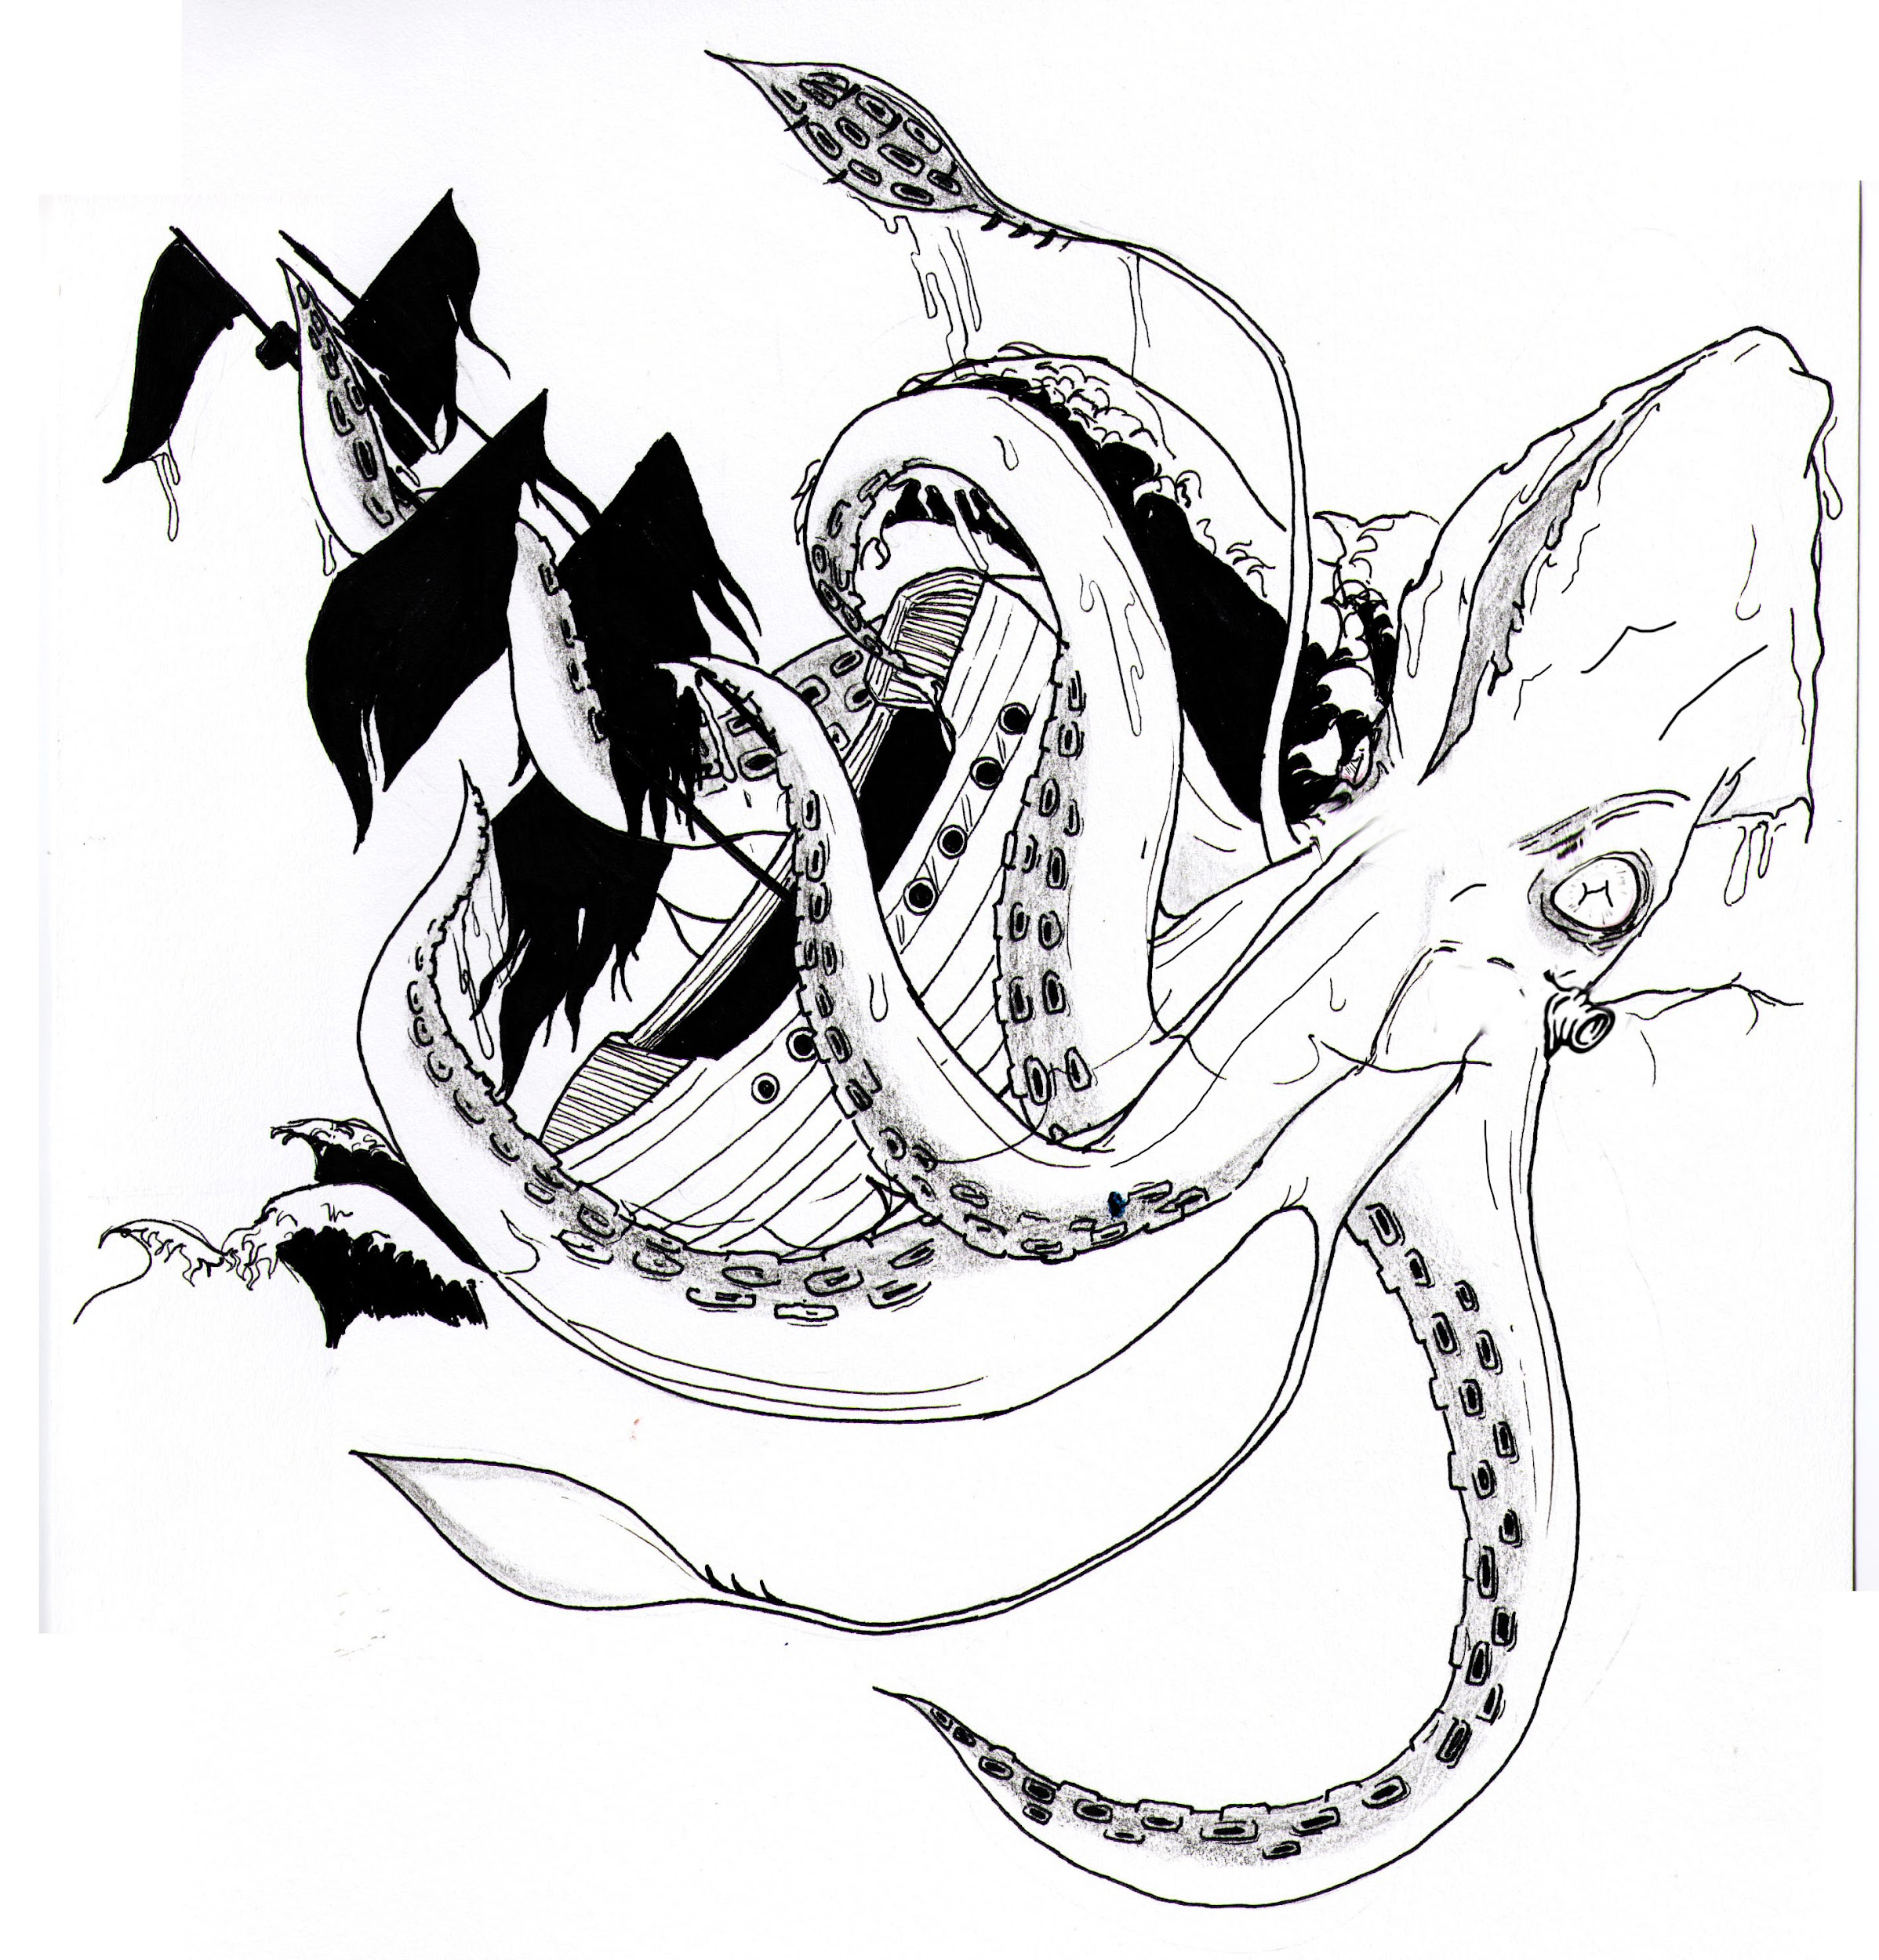
How big is this kraken, really?
Short answer: It's probably bigger than you think
For a sampling of 127 internal modules
3,944 versions of 347 unique modules
95,118 dependency edges
Notes:
I know what you're thinking … how much of a problem is this actually? Does it warrant all this since everything is in the module cache anyway?
[advance]
The short version is … it's probably bigger than you think.
[advance]
I sampled 127 of our internal modules. The dependency trees contained around 4K versions of 350 unique modules and a total of 95K dependency edges. That's not close to our entire codebase and, as each of those modules get future releases, that number will only grow

Slide 19
Querying the Graph
$ perseus help query
Executes a query against the Perseus graph
Usage:
perseus query [command]
Aliases:
query, q
Available Commands:
ancestors Outputs the list of modules that the specified module depends on
descendants Outputs the list of modules that depend on the specified module
list-modules Outputs the list of modules, along with the highest version, that match a provided glob pattern
Flags:
--dot specifies that the output should be a DOT directed graph (not supported for list-modules)
-f, --format string provides a Go text template to format the output.
Each result is an instance of the following struct:
type Item struct {
// the module name and version, ex: github.com/CrowdStrike/perseus and v0.11.38
Path, Version string
// true if this module is a direct dependency of the "root" module, false if not
IsDirect bool
// the number of dependency links between this module and the "root" module
// - direct dependencies have a degree of 1, dependencies of direct dependencies
// have a degree of 2, etc.
Degree int
}
The Name() method also returns a string containing "[Path]@[Version]".
-h, --help help for query
--json specifies that the output should be formatted as JSON
--list specifies that the output should be formatted as a tabular list
--max-depth int specifies the maximum number of levels to be returned (default 4)
--server-addr string the TCP host and port of the Perseus server
Global Flags:
-x, --debug enable verbose logging
Notes:
Now that we have all of this data, how can we make use of it?
For that, the Perseus CLI provides the 'query' command, with 3 sub-commands
'query list-modules' returns a list of the modules in the Perseus database that match a provided pattern
Following a parent/child lineage analogy, 'query ancestors' returns things that the specified module *depends on* and 'query descendants' shows modules that *depend on* it
Each command has several options for output formatting

Slide 20
Querying the Graph
Ancestors/Dependencies
# list the path and version of the direct dependencies of Perseus
$ perseus query ancestors github.com/CrowdStrike/perseus --format '{{.Name}}' --max-depth 1
github.com/Masterminds/squirrel@v1.5.3
github.com/go-git/go-git/v5@v5.4.2
github.com/grpc-ecosystem/grpc-gateway/v2@v2.11.3
github.com/jackc/pgx/v4@v4.17.2
github.com/jmoiron/sqlx@v1.3.5
github.com/mattn/go-isatty@v0.0.16
github.com/soheilhy/cmux@v0.1.5
github.com/spf13/cobra@v1.5.0
github.com/spf13/pflag@v1.0.5
github.com/theckman/yacspin@v0.13.12
golang.org/x/mod@v0.1.1-0.20191105210325-c90efee705ee
golang.org/x/sync@v0.0.0-20220601150217-0de741cfad7f
google.golang.org/genproto@v0.0.0-20220822174746-9e6da59bd2fc
google.golang.org/grpc@v1.49.0
google.golang.org/grpc/cmd/protoc-gen-go-grpc@v1.2.0
google.golang.org/protobuf@v1.28.1
Notes:
On these next few slides we'll look at some examples of 'perseus query'
This one lists the path and version of the direct dependencies of perseus itself.
Since no version is included in the query, the results will be for the most current known version
The output is 16 modules, which matches the list of required modules in the project's go.mod file

Slide 21
Querying the Graph
Ancestors/Dependencies
# show a table of the direct and indirect dependencies of Perseus
# within 4 degrees of separation
$ perseus query ancestors github.com/CrowdStrike/perseus --list
Dependency Direct
github.com/Masterminds/squirrel@v1.5.3 true
github.com/go-git/go-git/v5@v5.4.2 true
github.com/grpc-ecosystem/grpc-gateway/v2@v2.11.3 true
github.com/jackc/pgx/v4@v4.17.2 true
github.com/jmoiron/sqlx@v1.3.5 true
github.com/mattn/go-isatty@v0.0.16 true
github.com/soheilhy/cmux@v0.1.5 true
github.com/spf13/cobra@v1.5.0 true
github.com/spf13/pflag@v1.0.5 true
github.com/theckman/yacspin@v0.13.12 true
golang.org/x/mod@v0.1.1-0.20191105210325-c90efee705ee true
golang.org/x/sync@v0.0.0-20220601150217-0de741cfad7f true
golang.org/x/sys@v0.0.0-20220811171246-fbc7d0a398ab false
google.golang.org/genproto@v0.0.0-20220822174746-9e6da59bd2fc true
google.golang.org/grpc@v1.49.0 true
google.golang.org/grpc/cmd/protoc-gen-go-grpc@v1.2.0 true
google.golang.org/protobuf@v1.28.1 true
Notes:
This next one generates a columnar list of Perseus' direct and indirect dependencies within 4 degrees of separation.
4th from the bottom you can see the extra indirect ref to golang.org/x/sys compared to the last slide

Slide 22
Querying the Graph
Descendants/Dependants
# list the path and version of all modules that directly depend on cmux@v0.1.5
$ perseus query descendants github.com/soheilhy/cmux@v0.1.5 --max-depth 1 --format '{{.Name}}'
github.com/CrowdStrike/perseus@v0.1.1
github.com/CrowdStrike/perseus@v0.1.0
github.com/CrowdStrike/perseus@v0.0.0
# same thing, but output as a table
$ perseus q d github.com/soheilhy/cmux@v0.1.5 --max-depth 1 –-list
Dependent Direct
github.com/CrowdStrike/perseus@v0.1.1 true
github.com/CrowdStrike/perseus@v0.1.0 true
github.com/CrowdStrike/perseus@v0.0.0 true
# again, but de-duplicate by module path
$ perseus q d github.com/soheilhy/cmux@v0.1.5 --format '{{.Path}}' | uniq
github.com/CrowdStrike/perseus
Notes:
And here are a few examples of querying "down" the graph to show things that depend on a particular module/version
The first shows the path and version of all the modules that directly depend on cmux@v0.1.5, which is just 3 versions of Perseus here. It also used the option to apply a Go text template to the results to format the output. In this case, {{.Name}} calls the Name() method on the result item, which returns the module path and version with an @ in between.
The 2nd one shows the same thing, but as a table. And the last deduplicates the results by module path by applying a slightly different text template then piping the results through uniq

Slide 23
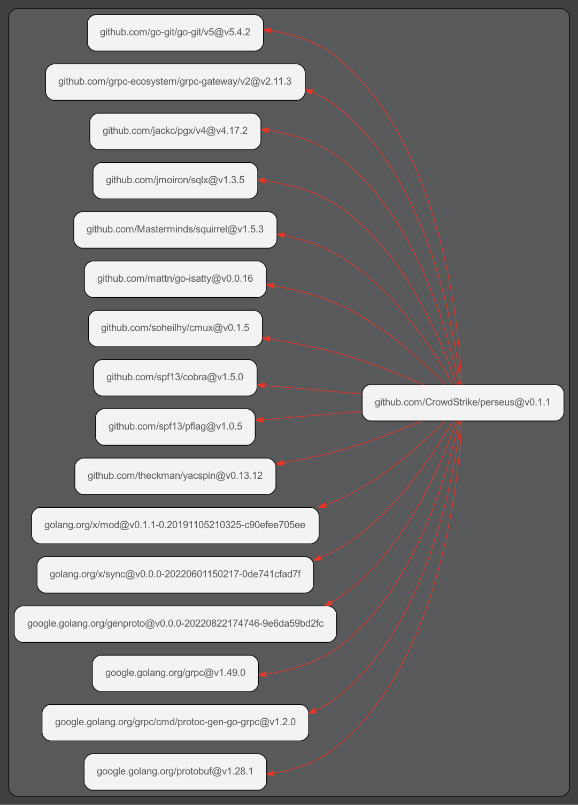
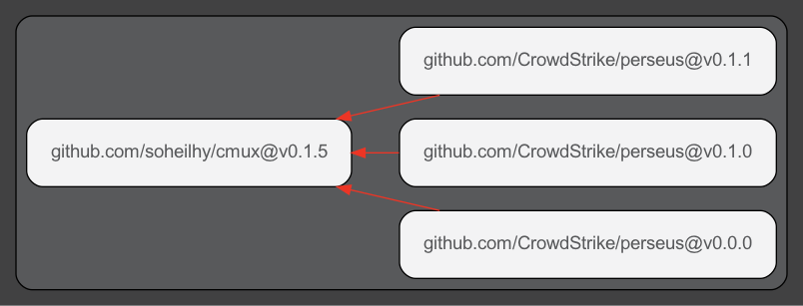
Rendering the Graph
# Generates the image to the right
$ perseus query ancestors github.com/CrowdStrike/perseus --dot | dot -Tpng -o perseus.png
# Generates the image below
$ perseus q d github.com/soheilhy/cmux --dot | dot -Tpng -o cmux.png
Notes:
With a little bit of terminal-fu was can also generate DOT directed graphs to make pretty pictures
The first command generates the image on the right and the second on generates the one at the bottom.
These simple commands are a part of why we chose not to do visualizations directly in the server. The API builds and returns the DOT directed graph content and it only takes a tiny bit of extra work to turn that into pictures.

Slide 24
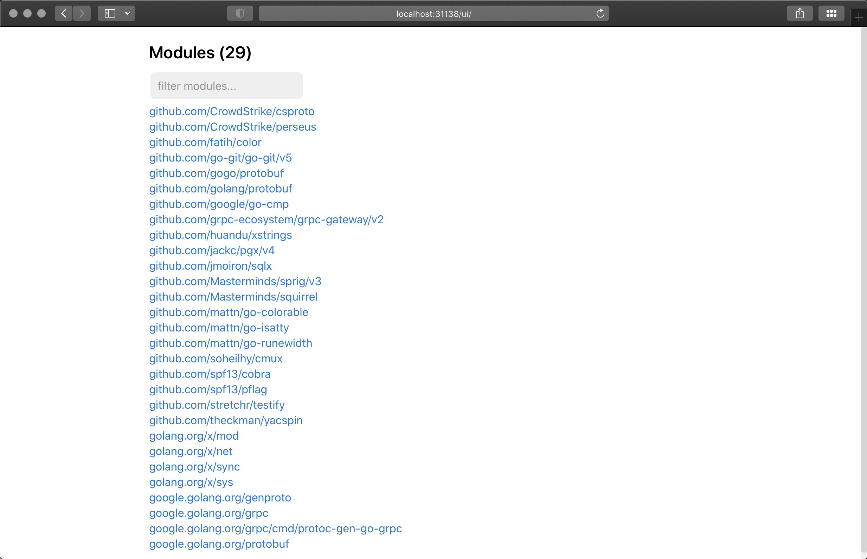
Notes:
I wasn't brave enough to tempt the live demo gods, but I do have some screen shots of the Perseus web UI. This one shows the list of modules in the database. Clicking a module opens a view that shows that module's dependencies or dependents

Slide 25
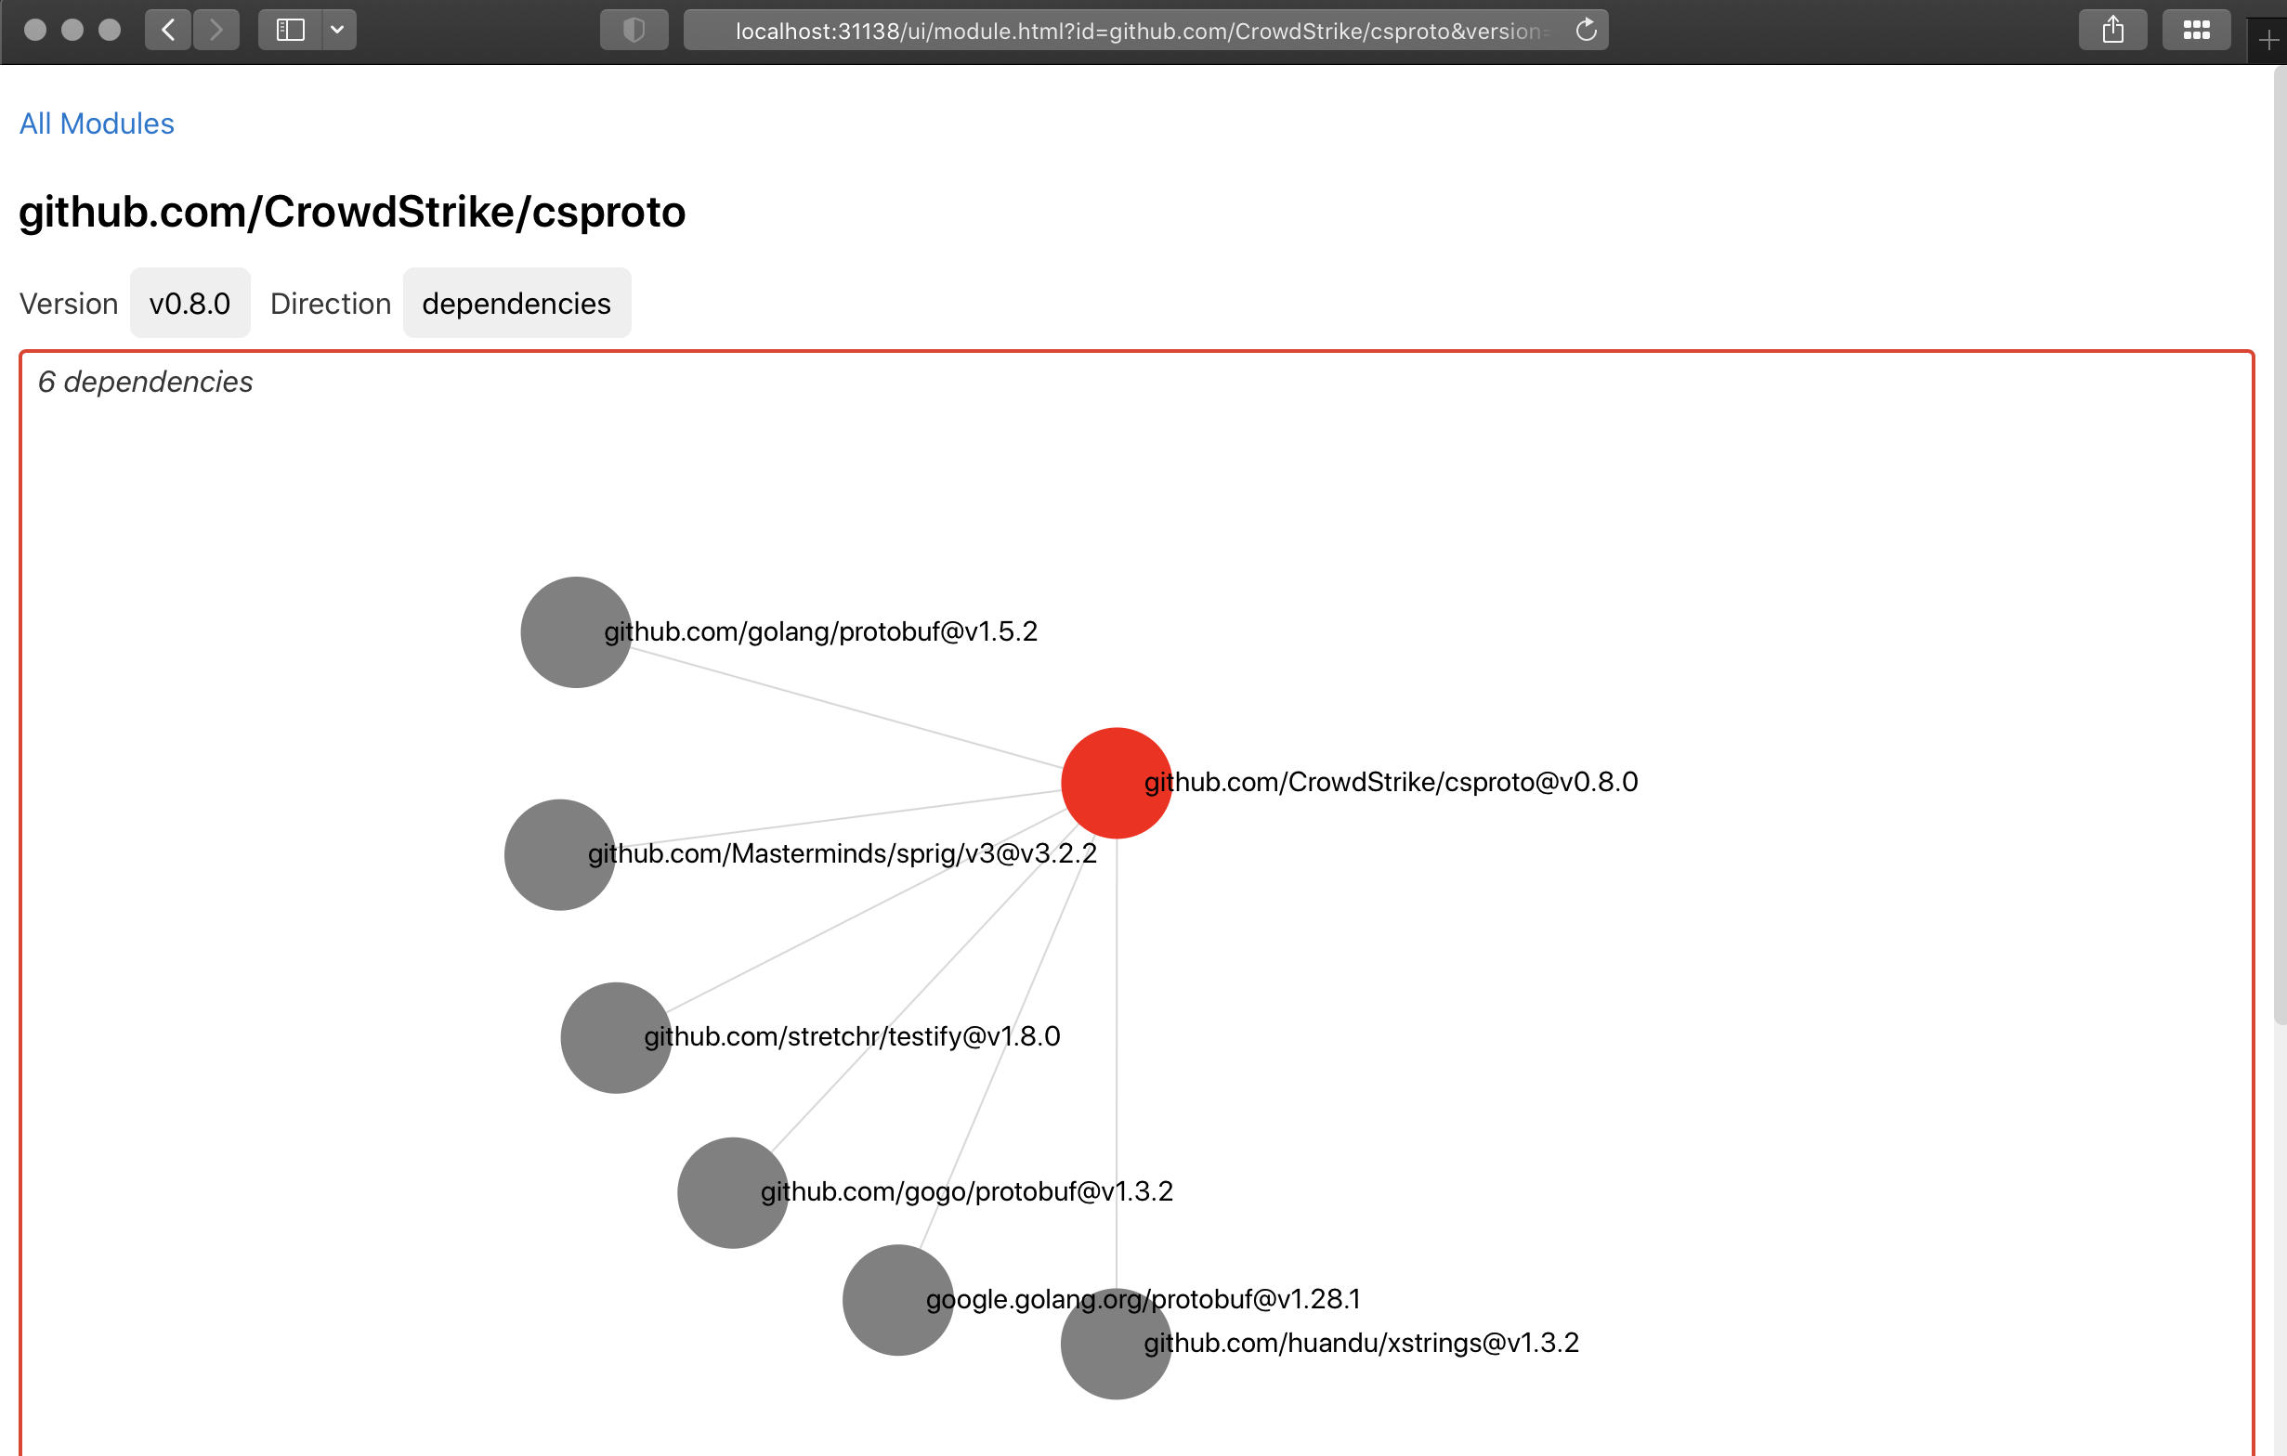
Notes:
The module detail view let's you select a version and direction then shows a single level of dependencies. You can dive down through the graph by clicking any of these nodes. Here we have the direct dependencies of v0.8.0 of csproto, another CrowdStrike open source project.

Slide 26
More Example Queries
# list all modules that depend on v1.12.1 of github.com/example/foo (within 6 degrees)
# and return the tree as JSON
$ perseus q d github.com/example/foo@v1.12.1 --max-depth 6
# emulate 'go list -m all' with a max of 10 hops
$ perseus q a github.com/example/bar --max-depth 10 --format '{{.Path}} {{.Version}}'
# 'go list -m all', but for things that *depend on* bar
$ perseus q d github.com/example/bar --max-depth 10 --format '{{.Path}} {{.Version}}' | uniq
Notes:
Here we have a few more more query examples.
The first will generate a JSON document containing things that depend on v1.12.1 of github.com/example/foo within 6 degrees.
The other 2 are emulating 'go list -m all' in both directions. Remember, you can't do that last one with go list

Slide 27
🛠 Advanced Queries 🛠
# Given a list of modules, report any that depend on themselves
reportInceptionModules() {
# $1 - space-delimited list of module/version strings
# $2 - optional max recursion depth, default 5
for m in $1; do
name=$(echo $m | sed 's/@.+//')
depth=${2:-5}
res=$(perseus q a $m --format '{{.Path}}' --max-depth $depth | grep "$mname" | uniq)
if [ -n "$res" ]; then
echo $mname has a cyclic dependency on itself
fi
done
}
$ reportInceptionModules $(perseus q list-modules 'github.com/example/*' --format '{{.Path}}')
Notes:
We can do even fancier things by employing a bit of Bash
This example outputs a list of "Inception" modules, those that depend on prior versions of themselves
Fun fact: Go still enforces that there are no package-level import cycles but nothing stops a module from depending on a prior version of itself indirectly, which makes for some fun times if you're also running a tool like Dependabot. Every release of that module triggers an update to itself. :(
We actually found one in our own codebase with this query and are in the process of correcting it.

Slide 28
🛠 Advanced Queries 🛠 (cont)
# Report all modules that match a pattern where the highest version depends on a specified dependency
reportModulesVulnerableVia() {
# $1 - glob pattern for modules to check
# $2 - vulnerable dependency, path@version
# $3 - optional max recursion depth, default 5
for m in $(perseus q lm $1 --format '{{.Name}}'); do
depth=${3:-5}
res=$(perseus q a $m --format '{{.Path}}' --max-depth $depth | grep "$2" | uniq)
if [ -n "$res" ]; then
echo $m depends on $2 and needs remediation
fi
done
}
$ reportModulesVulnerableVia 'github.com/example*' github.com/shady-code/oh-noes@v1.42.13
Notes:
This one reports modules where the most current version depends on a specific version of a dependency, say one with a reported CVE
A CVE can be considered "patched", at least from a code standpoint, if the module's latest release doesn't depend on the vulnerable version.
But just searching for _any_ reference to that module/version would generate false positives since it would include older versions of your modules.
This script combines 'query list-modules' to get the latest version of each module in the github.com/example org and 'query ancestors' to show it's dependencies.
The shady-code/oh-noes modules has a vulnerability in v1.42.13 so we want to make sure that everything has been updated to a newer release.

Slide 29
Future Improvements
Nicer UI
GraphQL API
New perseus query ... subcommands for common operations
Ability to read module versions and go.mod from module proxies or VCS for public repos
Publish pre-built Docker images for running the server
The project is on GitHub at github.com/CrowdStrike/perseus
PRs are certainly welcome
Notes:
The current modules tooling is not ideal, but by applying a bit of "elbow grease" we were able to address the shortcomings pretty easily.
Perseus has served us well and we hope he can do the same for all of you.
We have plans to make Perseus even better... things like a nicer UI and a GraphQL API have come up, along with adding new 'perseus query' sub-commands for common things. We're also looking at adding support for reading deps for public modules from proxies or VCS and possibly publishing pre-built Docker images for running the server.
The project is available on GH so everyone go check it out. Looking forward to seeing ideas for making Perseus even more powerful.

Slide 30
Credits
Perseus and Andromeda - Giuseppe Cesari - [1], Public Domain, https://commons.wikimedia.org/w/index.php?curid=31673524
Caveman image by Vecteezy - https://www.vecteezy.com/free-vector/history
OSS Projects
pg-semver Extension - https://github.com/theory/pg-semver
grpc-gateway - https://github.com/grpc-ecosystem/grpc-gateway
cmux - https://github.com/soheilhy/cmux
Buf - https://buf.build
Notes:
Before I go … I have to give credit where credit is due.
CC and public domain images are wonderful but don't just use them. Cite the artists, please.
OSS is awesome. I couldn't have built Perseus without the pg-semver, cmux, and grpc-gateway projects.
Go check out Buf. They're doing good things.

